Slide 1

2011 Space Weather Enterprise Forum
Solar Maximum: Can We Weather the Storm?
Sponsored by National Space Weather Program Council
Commerce, Defense, Energy, Homeland Security, Interior, State, Transportation, NASA, NSF Office of the Federal Coordinator for Meteorological Services and Supporting Research

Slide 2
2011 Space Weather Enterprise Forum
Mr. Samuel P. Williamson
Federal Coordinator for Meteorology and Chairman, National Space Weather Program Council
June 21, 2011
Washington, DC

Slide 3
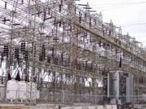
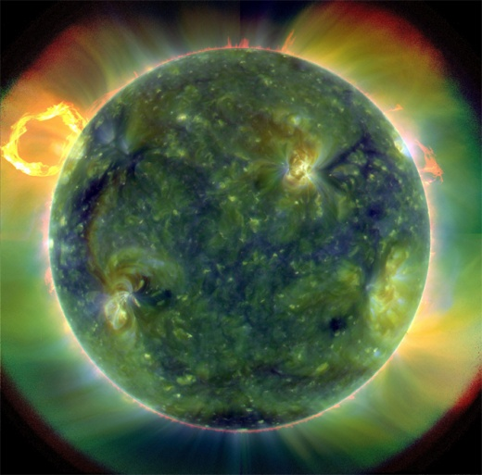
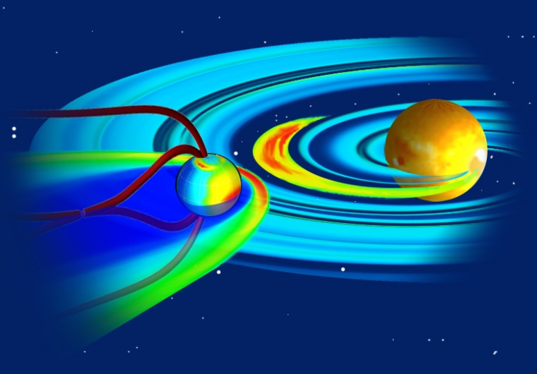
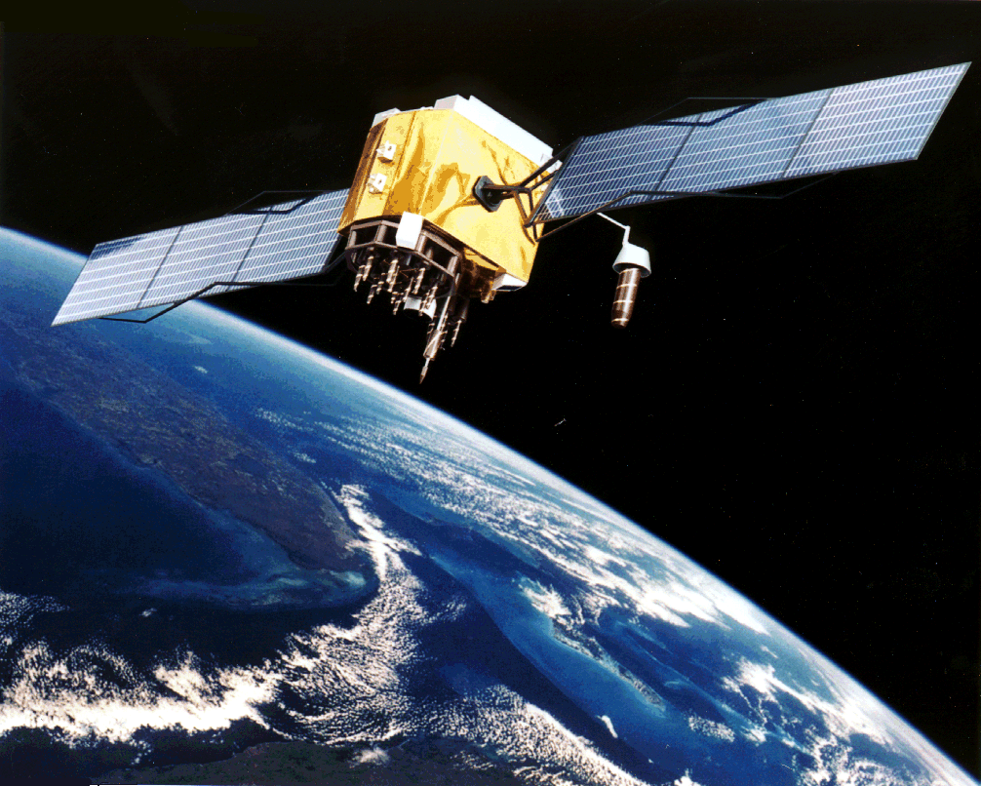
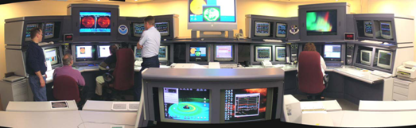
Why are we here?
Sponsors
Objectives
Agenda
Keynote and Invited Speaker

Slide 4
NSWP Council sponsors the Forum
Council Membership
Commerce: NOAA
Defense: Air Force, Navy
Energy
Homeland Security: FEMA
Interior: US Geological Survey
State
Transportation: FAA
NASA
NSF
OSTP and OMB (Observers)
August 2008 – Council agreed to host and organize the Space Weather Enterprise Forum
Charter
Provide oversight and direction to integrated process of setting national priorities, focusing agency efforts, and leveraging existing resources

Slide 5
Strengthening the Enterprise
Objectives
Share information across the enterprise and raise awareness for new users, decision makers, and policymakers
Identify effective approaches to raise awareness in the broader society
Identify effective approaches to build resilience across society, particularly in critical infrastructure protection and support
Improve communication within and external to the enterprise
Collect information to support a new National Space Weather Program Implementation Plan

Slide 6
Agenda
Session 1: Welcome and Opening Addresses
Forum Objectives and Overview
Keynote: The Honorable Yvette D. Clarke, 11th District of New York, U.S. House of Representatives
Invited Speaker: Dr. Margaret “Marge” Cavanaugh, Deputy Assistant Director, Geosciences Directorate, National Science Foundation

Slide 7
Agenda
Session 2: Critical Infrastructure Vulnerability to Space Weather
Moderator: Mr. Joe McClelland, Director, Office of Electric Reliability, Federal Energy Regulatory Commission
Mr. John Kappenman, Storm Analysis Consultants
Mr. Eric Rollison, Engineer of Reliability Assessments, North American Electric Reliability Corporation
Mr. Mitch Narins, Chief System Engineer for Navigation Services, Federal Aviation Administration
Mr. Tim Deaver, Vice President, Hosted Payload Development, SES World Skies U.S. Government Solutions

Slide 8
Agenda
Session 3: Human Safety and Response Preparedness
Moderator: Mr. Jonathan T. “Jon” Malay, Director, Civil Space and Environment Programs, Lockheed Martin; President, American Meteorological Society
Mr. Michael Stills, Manager – International Operations, United Flight Dispatch
Mr. Leviticus (L.A.) Lewis, FEMA Representative, DHS Space Team
Dr. John Allen, Program Executive for Crew Health and Safety, NASA HQ, Space Operations Mission Dir.
Dr. Brenda Phillips, Professor, Center for the Study of Disasters and Extreme Events, Okla State Univ

Slide 9
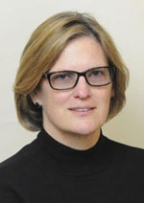

Agenda
Luncheon
Speaker: Dr. Kathryn Sullivan, Assistant Secretary of Commerce for Environmental Observation and Prediction

Slide 10
Agenda
Session 4: Space Weather Warnings and Prediction Services
Moderator: Ms. Maria Pirone, Sr. Account Manager, Environmental Systems, Harris Corp.
Dr. Jack Hayes, Assistant Administrator for Weather Services and Director, National Weather Service
Colonel John Egentowich (PhD), Deputy Director of Weather, HQ U.S. Air Force
Dr. Michael Hesse, Chief, Space Weather Laboratory, NASA Goddard Space Flight Center
Dr. Richard Behnke, Head, Geospace Section, National Science Foundation
Dr. David Applegate, Associate Director for Natural Hazards, USGS

Slide 11
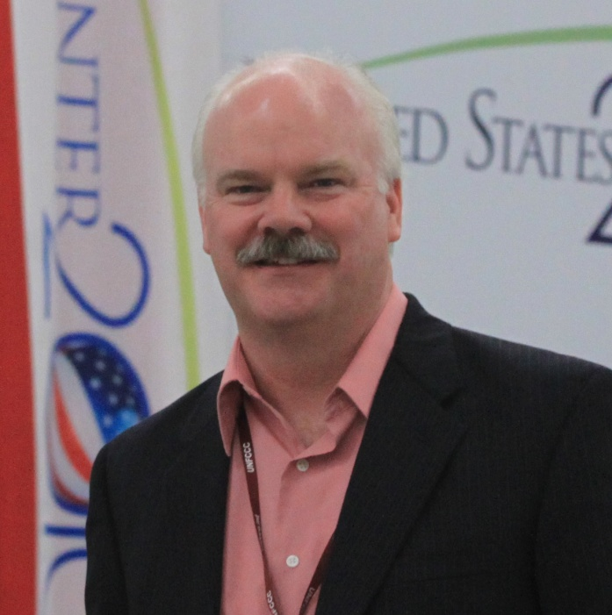
Agenda
Featured Speaker:
Mr. David Jones President, StormCenter Communications, Inc.

Slide 12
Agenda
Session 5: Strategic Communications, Education and Outreach
Moderator: Mr. David Jones, President, StormCenter Communications, Inc.
Ms. Victoria Jaggard, Space Editor, National Geographic News Online
Mr. Robert Irion, Director, Science Communication Program, University of California, Santa Cruz
Lieutenant Lesley Lykins, Director, Emerging Media Integration, Dept of the Navy, Office of Information
Dr. W. Jeffrey Hughes, Director, Center for Integrated Space Weather Modeling, Boston University
Mr. Clay Anderson, Senior Media Representative, Pepco Holdings, Inc.

Slide 13
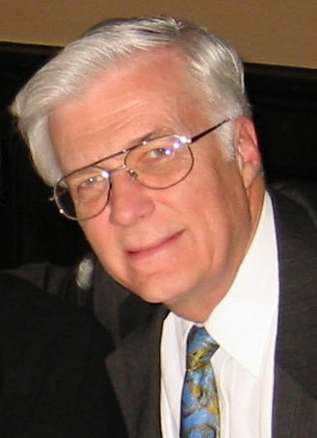
Agenda
Session 6: Summary and Wrap-Up
Dr. Paul Try, Sr. Vice President and Program Manager, Science and Technology Corporation
Reception, Networking, and Informal Discussions 5 to 6:30 p.m. in the First Amendment Room

Slide 14
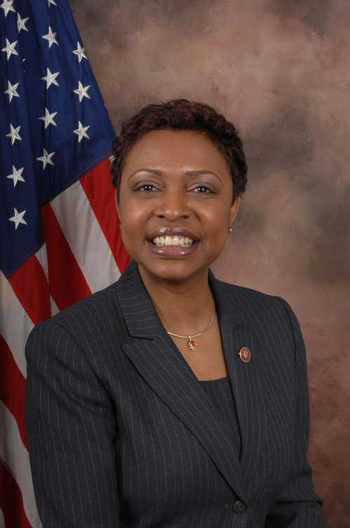
Keynote Address
The Honorable Yvette D. Clarke 11th District of New York U.S. House of Representatives
Member, House Committee on Homeland Security
Ranking Member of the Subcommittee on Cybersecurity, Infrastructure Protection, and Security Technologies
Member, House Committee on Small Business

Slide 15
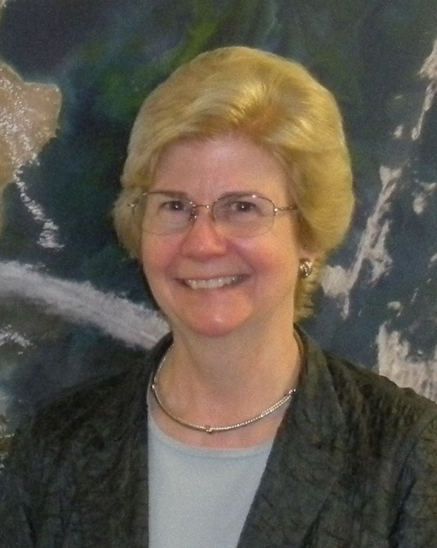
Invited Speaker
Dr. Margaret Cavanaugh Deputy Assistant Director Geosciences National Science Foundation

Slide 16
2011 Space Weather Enterprise Forum
Solar Maximum: Can We Weather the Storm?
Sponsored by National Space Weather Program Council
Commerce, Defense, Energy, Homeland Security, Interior, State, Transportation, NASA, NSF Office of the Federal Coordinator for Meteorological Services and Supporting Research

